Slide 1
Data Analysis Project 1.
Predicting Stock Returns Using Machine Learning
Oct 27, 2024
Group Members: Kai Ren, WeiJie Zhang, Yang Lan, YiMing Jiang, Rui Hu

Slide 2
Data Analysis Framework
Component Stocks of CSI500
Collecting Dataset
Factor Engineering
Training Model
Backtesting
Daily & Min Trading
Data
Fundamental
Data
Macro
Data
Factors Importances Analysis
Daily Trading
Factors
Fundamental
Factors
Macro
Factors
Return
Labels
Factors Importance
Select & Normalize
Machine Learning Models 🔥
Adjustance for
Less Overfitting
MLP
LSTM
···
Conv
Trained Models ❄️
Future Return
Prediction
Market Actions
Backtesting
MLP
LSTM
···
Conv
Fig 1. The Framework of Data Analysis Project 1.

Slide 3
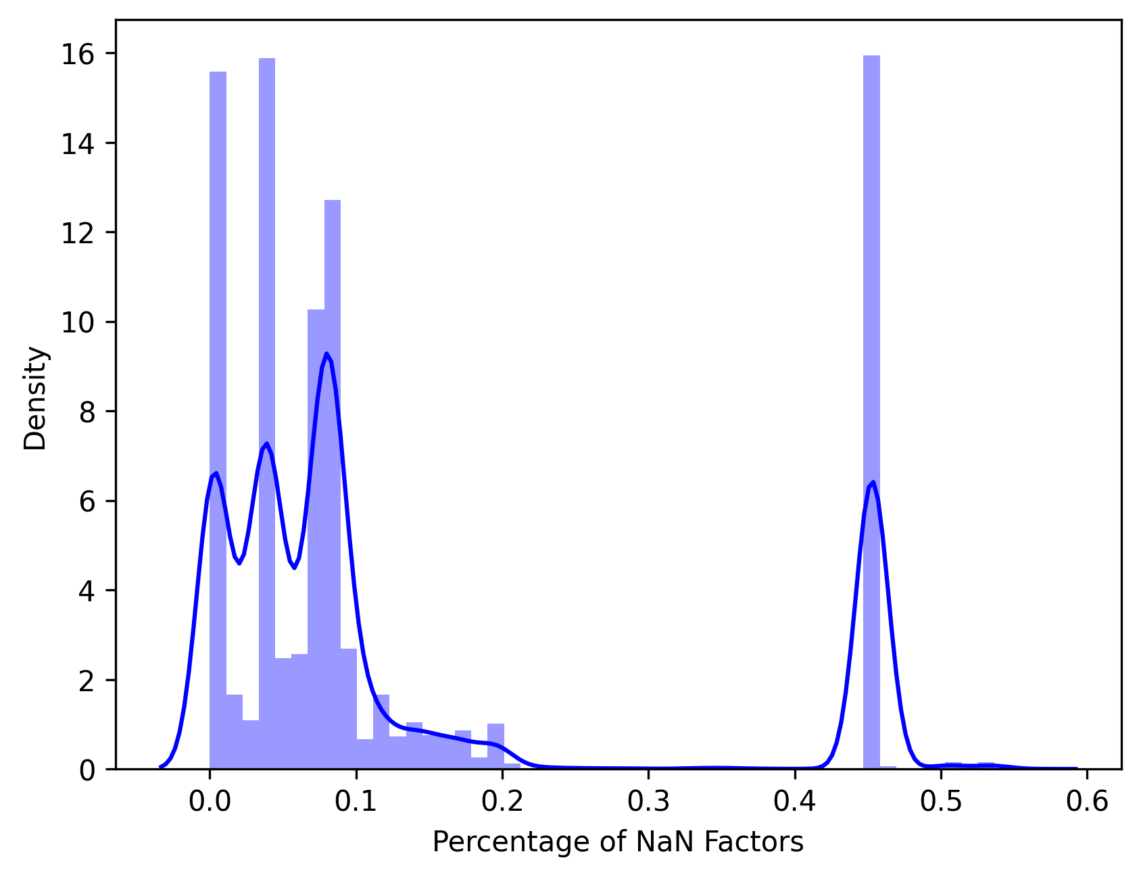
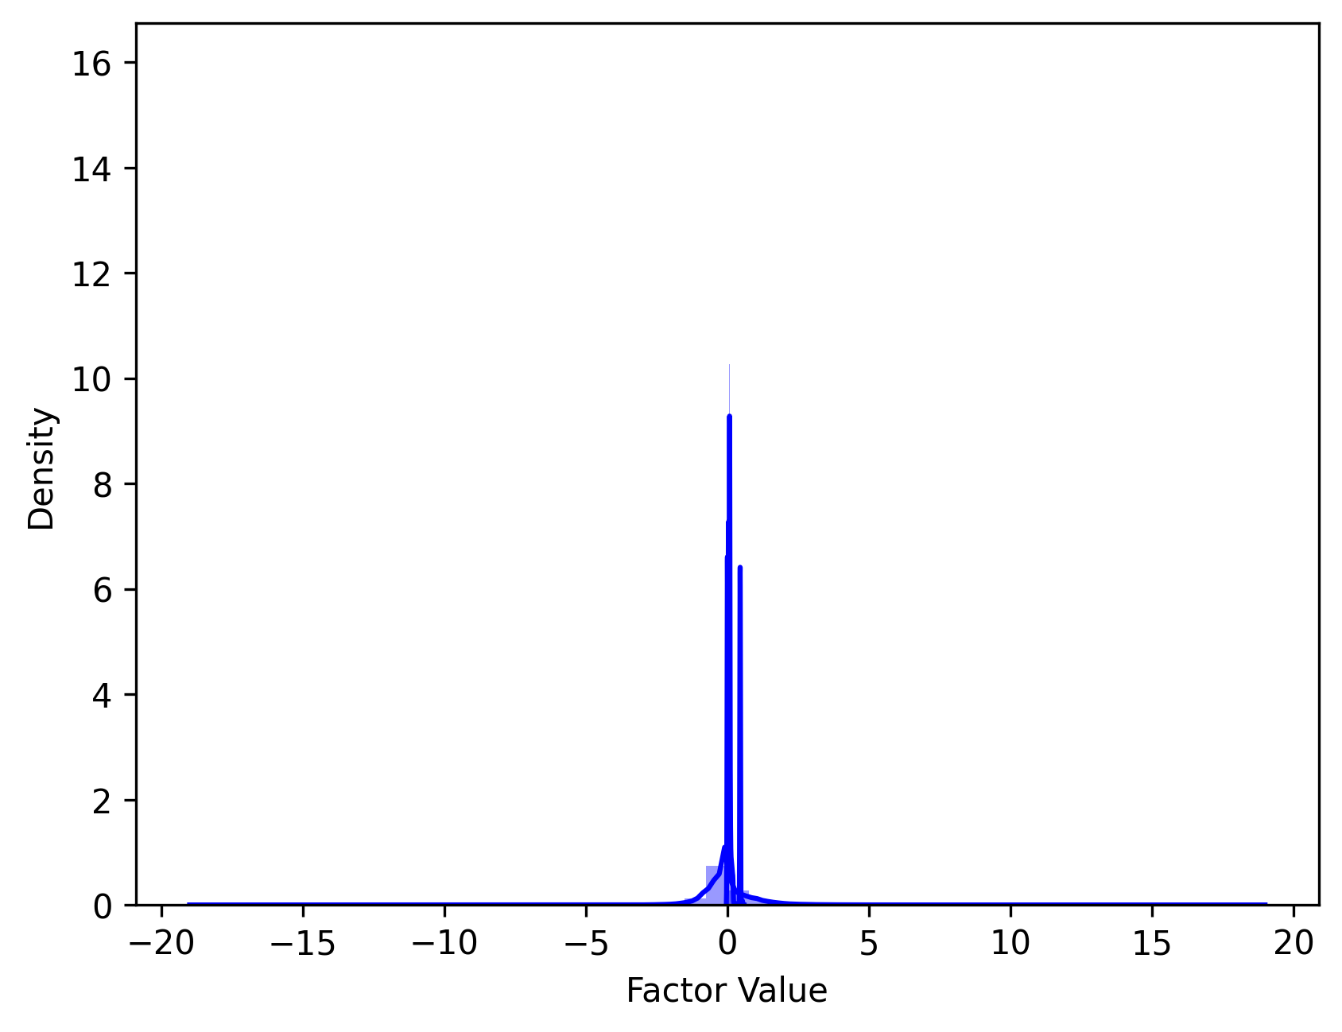
3.1 Select & Normalize
Raw Samples
(500 stocks, 606475 samples)
Samples have
NaN Label
Samples have too many NaN Factors
Slected Samples (Fill NaN by 0)
(360 stocks, 449765 samples)
Cross Sectional
Z-Score Normalization
Normed Samples
Fig 2. The Distribution of Nan Factors Percentage. We dropped samples where the percentage of NaN factors was greater than 10%.
Fig 3. The Select & Normalize Workflow. We also present the normed data distribution here.

Slide 4
3.2 In-Sample & Out-Sample Modeling
Normed
Factors
Daily Return
Label
Normed Samples
Train
Valid
Test
or
Discrete:
0-decrease; 1-no change; 2- increase
MSE Loss
CE Loss
Regression Modeling
Classification Modeling
Return Prediction
Discrete Prediction
All Samples to Train/Valid/Test
➸ In-Sample Modeling
Use Label to
Compute Metrics
Split to Train/Valid/Test
➸ Out-Sample Modeling
F1 Score & ACC
Fig 4. In-Sample and Out-Sample Modeling Framework.

Slide 5
Tables – alternative data table
 | Subhead | Subhead | Subhead | Subhead | Subhead | Subhead
Row 1 | xx | xx | xx | xx | xx | xx
Row 2 | xx | xx | xx | xx | xx | xx
Row 3 | xx | xx | xx | xx | xx | xx
Row 4 | xx | xx | xx | xx | xx | xx
Subtotal | xx | xx | xx | xx | xx | xx
Row 1 | xx | xx | xx | xx | xx | xx
Row 2 | xx | xx | xx | xx | xx | xx
Row 3 | xx | xx | xx | xx | xx | xx
Row 4 | xx | xx | xx | xx | xx | xx
Subtotal | xx | xx | xx | xx | xx | xx
Total | xx | xx | xx | xx | xx | xx

Slide 6
Tables – table with text
 | Subhead | Subhead
Row description | Text line (if not needed, delete) Bullet Dash Sub bullet | Text line (if not needed, delete) Bullet Dash Sub bullet
Row description | Text line (if not needed, delete) Bullet Dash Sub bullet | Text line (if not needed, delete) Bullet Dash Sub bullet
Row description | Text line (if not needed, delete) Bullet Dash Sub bullet | Text line (if not needed, delete) Bullet Dash Sub bullet

Slide 7
Tables – table with full column of bullets and dashes
Subhead | Subhead | Subhead | Subhead
Text line Bullet Dash Sub bullet | Text line Bullet Dash Sub bullet | Text line Bullet Dash Sub bullet | Text line Bullet Dash Sub bullet
Text line Bullet Dash Sub bullet | Text line Bullet Dash Sub bullet | Text line Bullet Dash Sub bullet | Text line Bullet Dash Sub bullet

Slide 8
Tables – chevron table
Text
Text, Palatino Linotype, 14-pt bold
Text
Text
Text
Subhead | Subhead | Subhead | Subhead
Heading Bullet Dash Sub bullet | Heading Bullet Dash Sub bullet | Heading Bullet Dash Sub bullet | Heading Bullet Dash Sub bullet
Heading Bullet Dash Sub bullet | Heading Bullet Dash Sub bullet | Heading Bullet Dash Sub bullet | Heading Bullet Dash Sub bullet
Heading Bullet Dash Sub bullet | Heading Bullet Dash Sub bullet | Heading Bullet Dash Sub bullet | Heading Bullet Dash Sub bullet

Slide 9
Text boxes – two text boxes with paragraph, bullet, and dash points
Text
Text
Paragraph (if not needed, delete)
Bullet
Dash
Sub bullet
Paragraph (if not needed, delete)
Bullet
Dash
Sub bullet

Slide 10
Text boxes – three to a slide, with paragraph, bullet, and dash points
Text
Text
Text
Text
Paragraph (if not needed, delete)
Bullet
Dash
Sub bullet
Paragraph (if not needed, delete)
Bullet
Dash
Sub bullet
Paragraph (if not needed, delete)
Bullet
Dash
Sub bullet

Slide 11
Text boxes – Four to a slide, with paragraph, bullet, and dash points
Text
Text
Text
Text
Text
Paragraph (if not needed, delete)
Bullet
Dash
Sub bullet
Paragraph (if not needed, delete)
Bullet
Dash
Sub bullet
Paragraph (if not needed, delete)
Bullet
Dash
Sub bullet
Paragraph (if not needed, delete)
Bullet
Dash
Sub bullet

Slide 12
Text boxes – two-by-two
Text
Text
Text
Paragraph (if not needed, delete)
Bullet
Dash
Sub bullet
Paragraph (if not needed, delete)
Bullet
Dash
Sub bullet
Text
Text
Paragraph (if not needed, delete)
Bullet
Dash
Sub bullet
Paragraph (if not needed, delete)
Bullet
Dash
Sub bullet

Slide 13
Text boxes – three-by-two
Text
Text
Text
Text
Paragraph (if not needed, delete)
Bullet
Dash
Sub bullet
Paragraph (if not needed, delete)
Bullet
Dash
Sub bullet
Paragraph (if not needed, delete)
Bullet
Dash
Sub bullet
Text
Text
Text
Paragraph (if not needed, delete)
Bullet
Dash
Sub bullet
Paragraph (if not needed, delete)
Bullet
Dash
Sub bullet
Paragraph (if not needed, delete)
Bullet
Dash
Sub bullet

Slide 14
Text boxes – two columns of numbered points for each point
1
Bullet
Dash
Sub bullet
Bullet
Dash
Sub bullet
2
Bullet
Dash
Sub bullet
Bullet
Dash
Sub bullet
3
Bullet
Dash
Sub bullet
Bullet
Dash
Sub bullet
4
Bullet
Dash
Sub bullet
Bullet
Dash
Sub bullet
5
Bullet
Dash
Sub bullet
Bullet
Dash
Sub bullet

Slide 15
Text boxes – two columns of numbered points for each point
1
6
Bullet
Dash
Sub bullet
Bullet
Dash
Sub bullet
2
7
Bullet
Dash
Sub bullet
Bullet
Dash
Sub bullet
3
8
Bullet
Dash
Sub bullet
Bullet
Dash
Sub bullet
4
9
Bullet
Dash
Sub bullet
Bullet
Dash
Sub bullet
5
10
Bullet
Dash
Sub bullet
Bullet
Dash
Sub bullet

Slide 16
Text boxes – two ways of showing major points
Text
Text
Bullet
Bullet
Bullet
Bullet
Bullet
Bullet
Text
Bullet
Bullet
Bullet
Bullet
Bullet
Bullet
Text
Bullet
Bullet
Bullet
Bullet
Bullet
Bullet
Text
Bullet
Bullet
Bullet
Bullet
Bullet
Bullet

Slide 17
Text boxes – major points with chevrons
Text
Text
Bullet
Bullet
Bullet
Bullet
Bullet
Bullet
Text
Bullet
Bullet
Bullet
Bullet
Bullet
Bullet
Text
Bullet
Bullet
Bullet
Bullet
Bullet
Bullet
Text
Bullet
Bullet
Bullet
Bullet
Bullet
Bullet

Slide 18
Text boxes – chevrons with text boxes
Text
Text, Palatino Linotype14-pt bold
Text
Text
Text
Paragraph (if not needed, delete)
Bullet
Dash
Sub bullet
Paragraph (if not needed, delete)
Bullet
Dash
Sub bullet
Paragraph (if not needed, delete)
Bullet
Dash
Sub bullet
Paragraph (if not needed, delete)
Bullet
Dash
Sub bullet

Slide 19
Text boxes – vertical chevrons with text
Text
Bullet
Dash
Sub bullet
Text
Bullet
Dash
Sub bullet
Text
Bullet
Dash
Sub bullet
Text
Bullet
Dash
Sub bullet

Slide 20
Text blocks – two squares
Paragraph (if not needed, delete)
Bullet
Dash
Sub bullet
Paragraph (if not needed, delete)
Bullet
Dash
Sub bullet
20

Slide 21
Text blocks – sources leading to
Text
Text
Paragraph (if not needed, delete)
Bullet
Dash
Sub bullet
Paragraph (if not needed, delete)
Bullet
Dash
Sub bullet
Text

Slide 22
Logic trees – executive summary tree
Report title
Main conclusion
Chapter title
Chapter title
Chapter title
Chapter title
Supporting conclusion
Supporting conclusion
Supporting conclusion
Supporting conclusion
Slide text
Dash
Slide text
Dash
Slide text
Dash
Slide text
Dash

Slide 23
Steps – two
Growth Path
Step 2 (if not needed, delete)
Bullet
Dash
Sub bullet
Step 1 (if not needed, delete)
Bullet
Dash
Sub bullet
xxx | Content Dash | Content Dash
xxx | Content Dash | Content Dash

Slide 24
Steps – three
Growth Path
Step 3 (if not needed, delete)
Bullet
Dash
Sub bullet
Step 2 (if not needed, delete)
Bullet
Dash
Sub bullet
Step 1 (if not needed, delete)
Bullet
Dash
Sub bullet
xxx | Content Dash | Content Dash | Content Dash
xxx | Content Dash | Content Dash | Content Dash

